Slide 1
MINI PROJECT ON DOCTOR MANAGEMENT APP
PSIT COLLEGE OF ENGINEERING
GROUP NO-18
SUBMITTED BY
NITIN KUMAR (1834810062)
DILIP YADAV (1834810032)
HARSHIT MISHRA (1834810037)
ATUL KUMAR GUPTA (1834810023)
SUBMITTED TO
AMIT KUMAR SHARMA
(Asst. Professor)

Slide 2
INTRODUCTION
Life is becoming too busy to get medical appointments in person and to maintain a proper health care. The main idea of this work is to provide ease and comfort to patients while taking appointment from doctors and it also resolves the problems that the patients has to face while making an appointment. The android application acts as a client whereas the database containing the doctor’s details, patient’s details and appointment details.

Slide 3
FEATURES OF THE APP
The application aims to saves time of people who stand in queue for Doctor Appointment.
Senior citizen can get a regular checkup by Doctor through this app.
It intend to provide health related information to patient.
Creates a friendly contact between patient and doctor.
Cheap and cost effective appointment.
Reduces burden of office going people.
Villagers can benefit through this app.
All time and anywhere facility available.

Slide 4
BLOCK DIAGRAM
DOCTOR MANAGEMENT APP
LOGIN
DOCTOR SIGNUP
PATIENT SIGNUP
DOCTOR LOGIN
PATIENT LOGIN
APPOINTMENT HISTORY
AVAILABLE DOCTORS
TAKE APPOINTMENT
APPOINTMENT SUCCESSFUL
APPOINTMENT REQUEST
PREVIOUS APPOINTMENT REQUEST
CURRENT APPOINTMENT REQUEST
PREVIOUS APPOINTMENT
CURRENT APPOINTMENT
BOOK MY APPOINTMENT

Slide 5
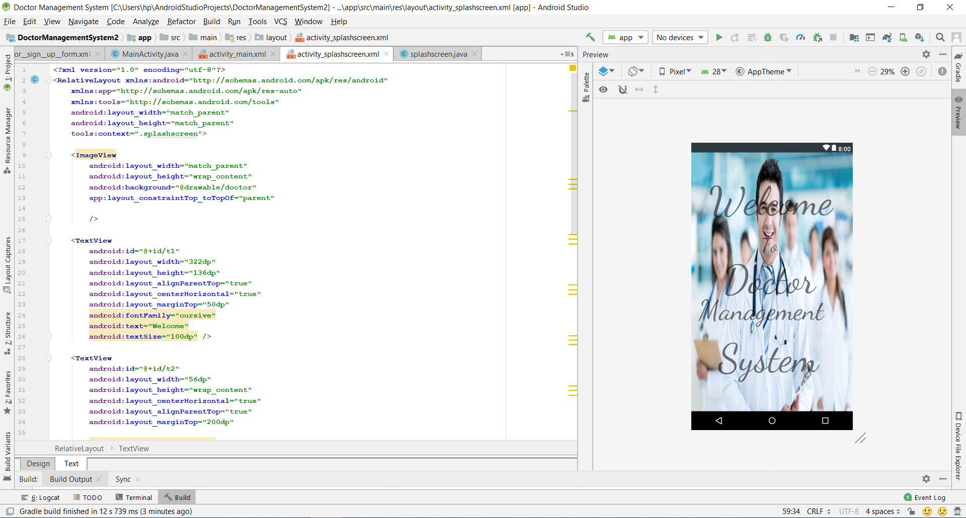
SPLASH SCREEN

Slide 6
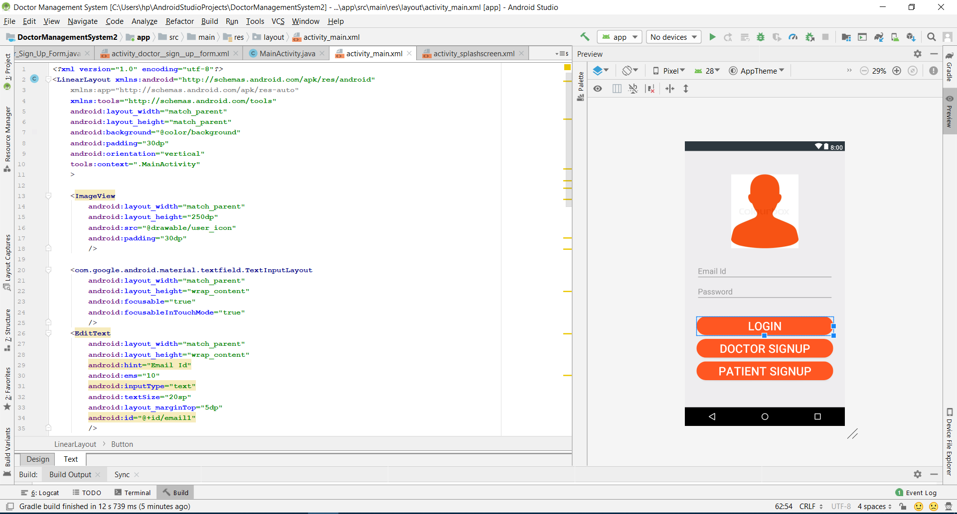
LOGIN PAGE

Slide 7
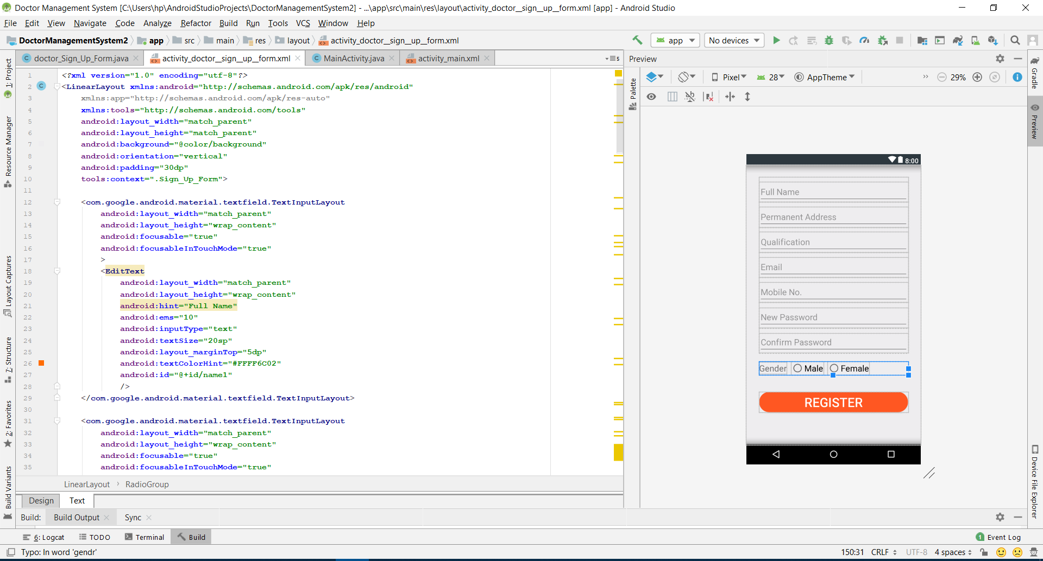
SIGN UP PAGE

Slide 8
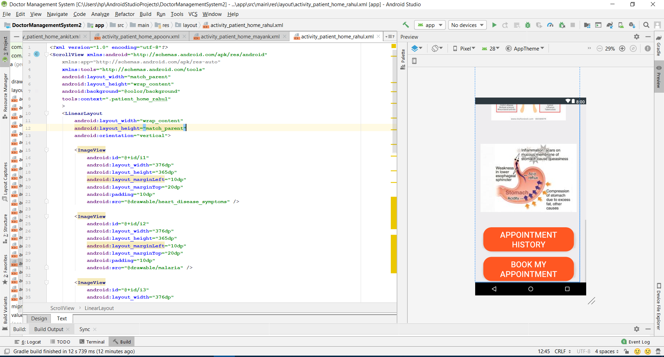
PATIENT HOMEPAGE

Slide 9
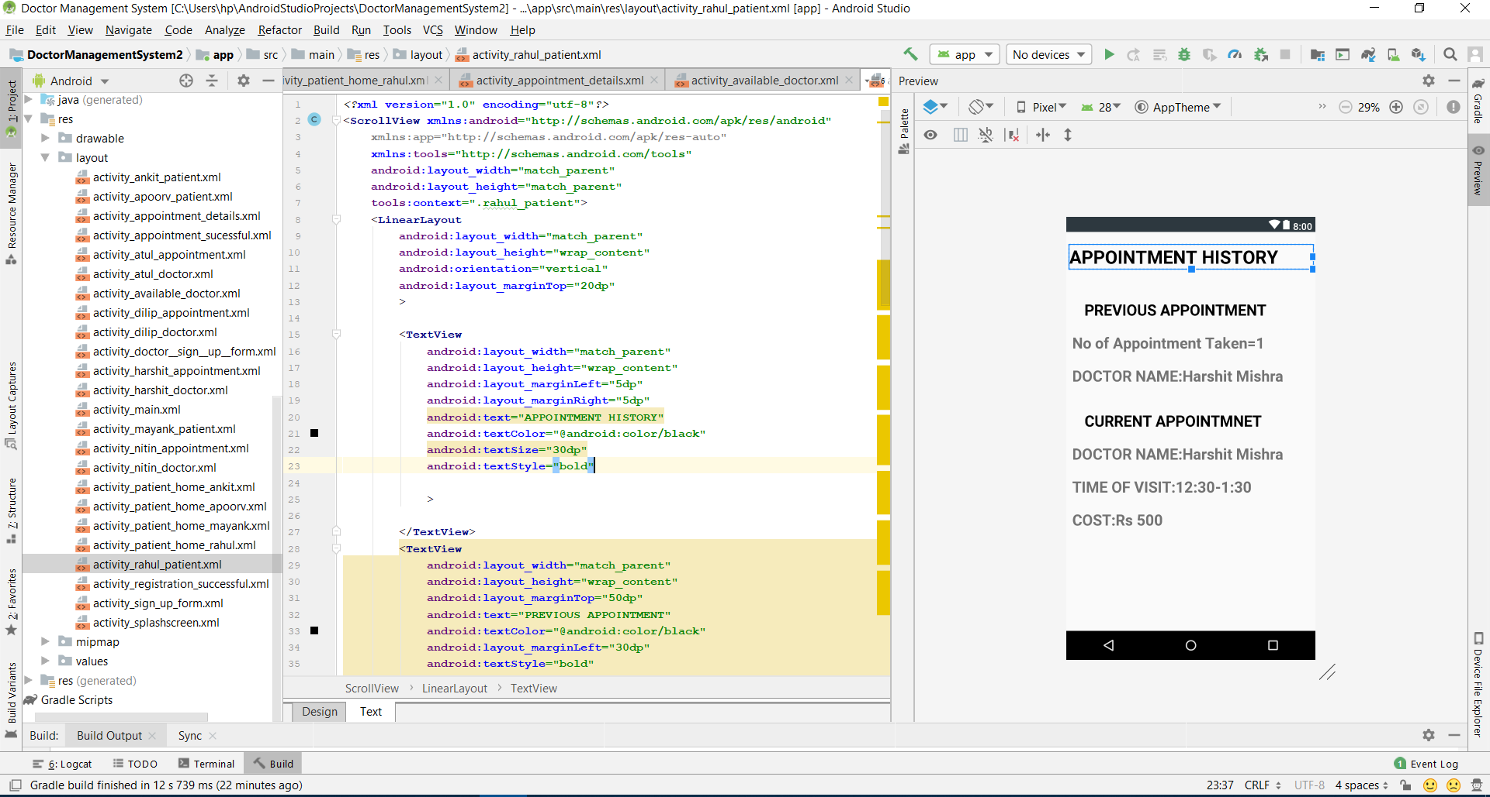
PATIENT APPOINTMENT HISTORY

Slide 10

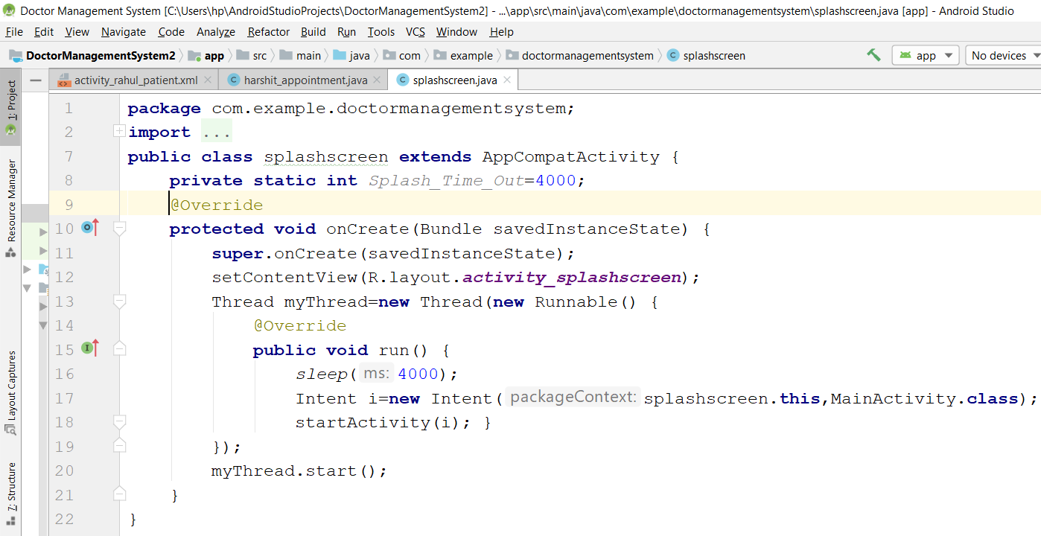
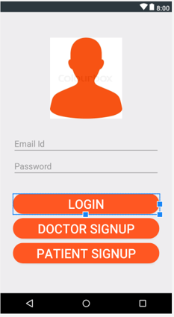
SPLASH SCREEN TO LOGIN PAGE LINKING

Slide 11
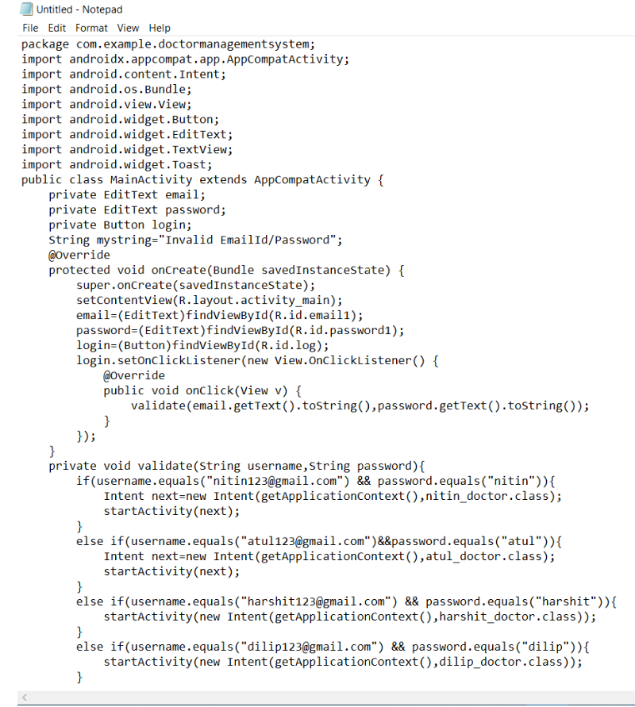
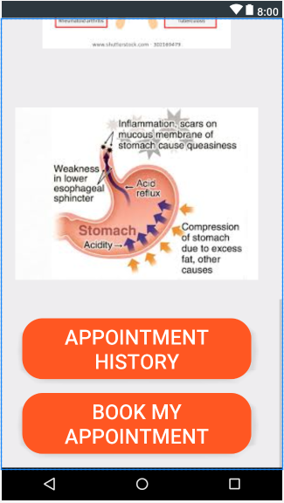
LOGIN TO PATIENT HOMEPAGE

Slide 12
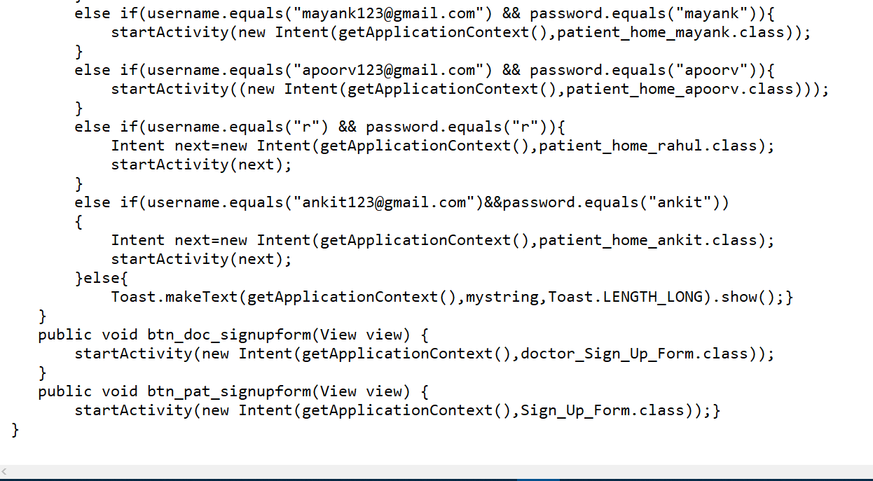
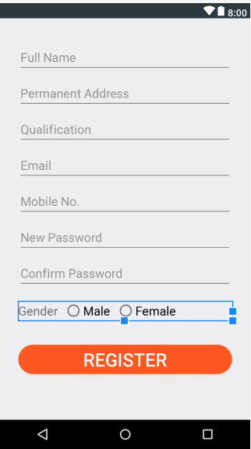
SIGNUP LINKING

Slide 13
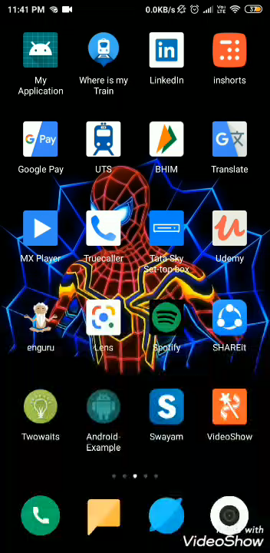
VIDEO OVERVIEW

Slide 14
FUTURE ASPECTS OF PROJECT
Solving Database problem linking.
Providing calling facility and email facility to doctor and patient.
Doctor search by location tracking of Doctor within certain kilometer range.
Providing the facility that doctor can reach our home anytime during emergency condition.
Providing home facility of ambulance and medicine.

Slide 15
REFERNCES
The following refernces are made in order to complete the project
1.Youtube Channel
…………..1.1 Arsl Tech(Coding references)
…………..1.2 Professor DK.
2.Google Searches
………….2.1 Geeks for Geeks
………….2.2 Stack overflow

Slide 16
THANK YOU !

